Slide 1
American Imperialism: Manifest Destiny Round 2? The Spanish-American War

Slide 2
What is Imperialism?
noun 1. the policy of extending the rule or authority of an empire or nation over foreign countries, or of acquiring and holding colonies and dependencies.
2. advocacy of imperial or sovereign interests over the interests of the dependent states.
3. imperial government; rule by an emperor or empress.
4. an imperial system of government.
5. British. the policy of so uniting the separate parts of an empire with separate governments as to secure for certain purposes a single state
Dictionary.com

Slide 3
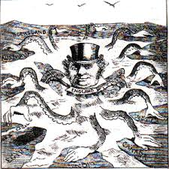
Examples:
Rome
England
France
Spain
“Colonialism” justified by spreading western “benefits”

Slide 4
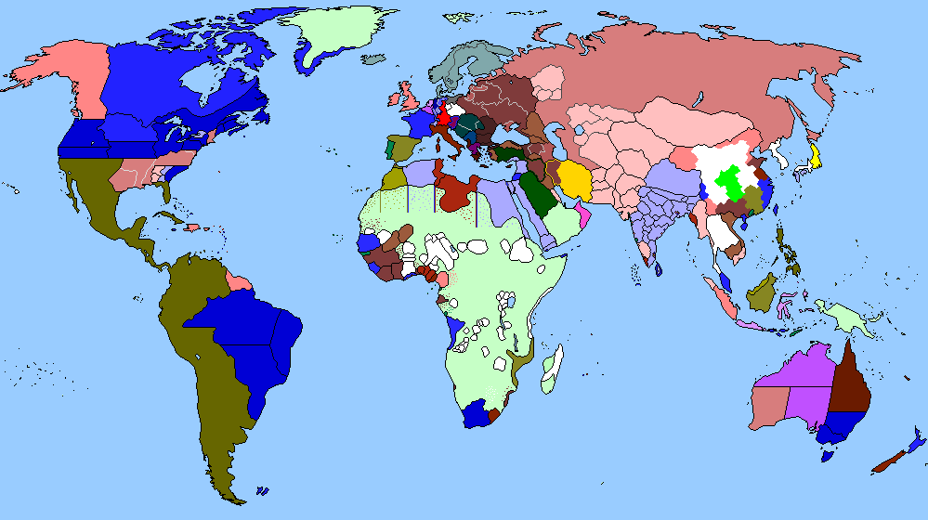
Spanish colonies in 1800s
Map of World 1875

Slide 5
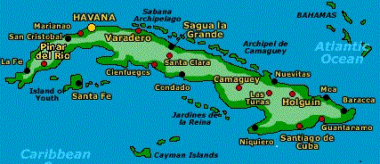
CUBA
Revolution for independence from Spain
3 years prior to start of Spanish-American War
U.S. interest because so close to coast
U.S. belief in ridding Western Hemisphere of colonial powers
Tensions grew between Spain and U.S.

Slide 6
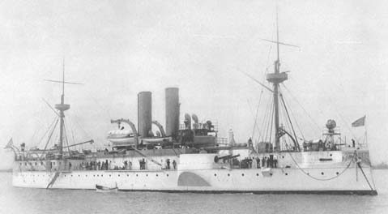
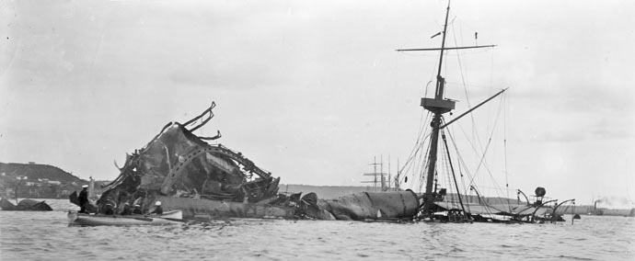
The Maine
Battleship Maine
Blew up and sank in Havana Harbor 2/15/1898
Mysterious circumstances…. Spain blamed…

Slide 7
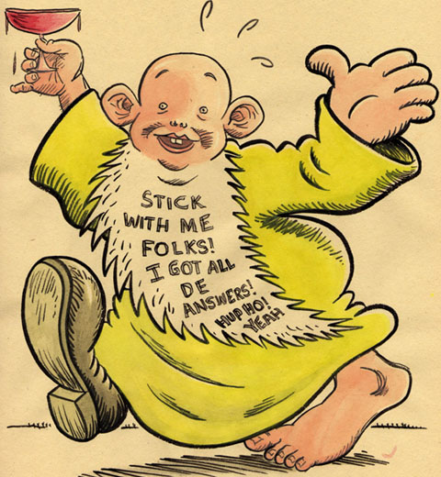
Yellow Journalism
Exaggerated
Story telling
Sensationalized
Muckrakers
The mystery of the Maine was covered extensively in the media and historians today believe that yellow journalism may have caused the Spanish-American War.

Slide 8
Spanish-American War timeline
April 1898
McKinley goes before Congress
Authorized to establish a “stable government” in Cuba
Congress acknowledges Cuba’s Independence
Give okay to use military
Spain rejects the proposal by the U.S.
McKinley places a blockade around Cuba
Spain declares war on the U.S.

Slide 9
Not so “Splendid Little War”
Secretary John Hay referred to the Spanish-American War as the “splendid little war”
Short:
1st : Battle of Manila Bay in May
Last: U.S. Navy defeats Spain in Cuba in June
Cease Fire: July
Treaty of Paris:
Cuba’s independence guaranteed
Spain cedes Guam and Puerto Rico to U.S.
Sells Philippines to U.S.

Slide 10
Ramifications of Little War
1898 Teller Amendment
Spain leaves = U.S. gives Cuba independence
1901 Platt Amendment
Terms of end U.S. Military in Cuba
Prohibited Cuba from entering into international treaties
That threaten their independence
Use of Cuba as a military base
U.S. had right to intervene
Defend
“Insure protection of life, property and individual liberty”

Slide 11
Ramifications continued
More stipulations for Cuba from Platt Amendment
Cuba had to improve their sanitation systems
Give up the Isle of Pines
Sell or lease land for coaling (fueling ships)
Sell or lease land for naval stations
Continual lease at Guantanamo Bay
Cuba had to agree to add Platt amendment to their constitution
So U.S. wasn’t breaking Teller Amendment

Slide 12
Progressives
Goal of Social Justice
America’s duty to spread American values and democracy
Defend other countries against potential imperialists
Support countries’ fights for independence
BUT not all of them… Domestic issues at home to deal with
Debate on what to focus on

Slide 13
Pro-expansion
Our responsibility to defend other countries’ independence against European colonizers
Create new markets for goods
Growing population
More jobs
More production
Need more places to sell them to
More raw materials
Overseas presence/influence
Dominance in the sea

Slide 14
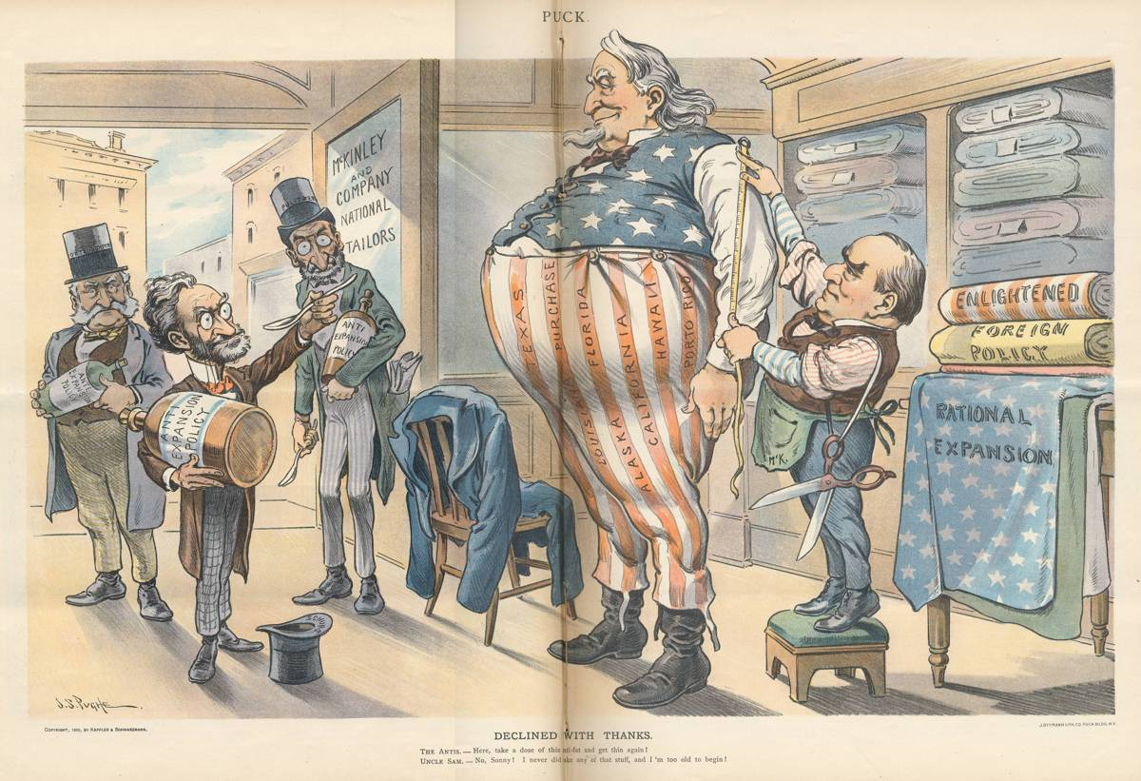

Slide 15
Monroe Doctrine
1823
U.S. responsibility to keep European countries from (re)colonizing the Western Hemisphere
Passive policy
1900s
U.S. as the international “policeman”

Slide 16
Big Stick
Roosevelt Corollary to the Monroe Doctrine
1904
U.S. will step in if other western hemisphere countries are unable to meet their obligations to other countries
U.S. will ensure their sovereignty
Used as justification to intervene in Cuba, Haiti, Nicaragua, Columbia and the Dominican Republic

Slide 17
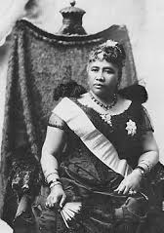
Just for Pineapples?
Hawaii
Why?
Pacific port
Sugar, pineapples
Other countries
How?
1893 Coup against Queen Liliuokalani by planters and large business owners
Put own government in place; request annexation
Why Hawaii and not Puerto Rico, Cuba or Guam?
More to offer as a state and more white Americans residing/operating businesses there

Slide 18
Panama Canal
makes trade easier, quicker and cheaper
Took advantage of Panama’s new independence from Columbia
U.S. will protect them in exchange for the canal
U.S. builds
Pays one time payment of $10m
$250k/year for 9 years
U.S. bought the Panama Canal Company for $40m 1904
Back and forth negotiations over the years with rent
In 2000 Panama owns
U.S. pays canal fees (like everyone else)

Slide 19
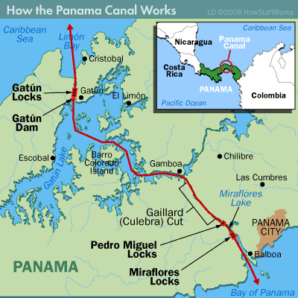

Slide 20
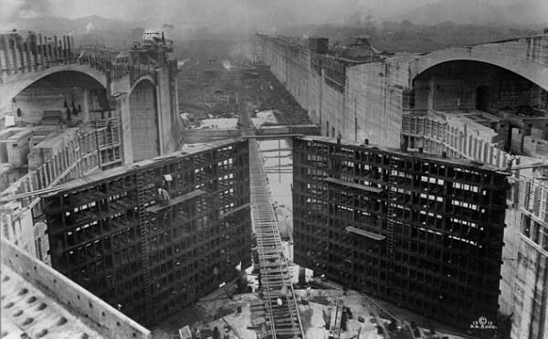
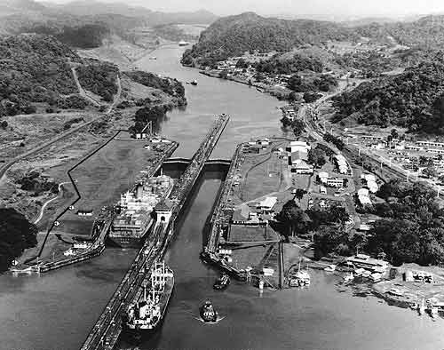
13k + ships pass/yr
NY to CA was 8000 miles less
Lifts ships 85 feet
25k men died during construction
Originally suppose to be in Nicaragua
100 years old August 2014

Slide 21
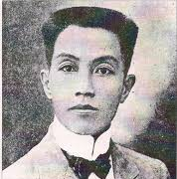
Philippine-American War 1899-1903
Right after Treaty of Paris (end of Spanish-American War)
Emilio Aguinaldo
Leader of Filipino nationalists against U.S. forces
4200 Americans died (mostly from disease)
20k Filipino soldiers
Estimated up to 200k Filipino civilians (violence, disease, famine)

Slide 22
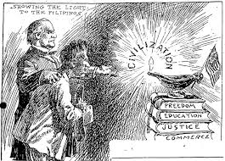

Slide 23
Philippine-American War timeline
Aguinaldo initially seized Luzon (main island)
Declared Independent Philippine Republic
U.S. called this an insurrection
Filipino Nationalists called it a war against an invader (U.S.)
2 Phases to the war
1. Conventional: bad idea for Filipino soldiers
U.S.: more trained, more equipment, fresh soldiers and supplies
2. Guerrilla: good idea, probably could have done better if had done this throughout

Slide 24
Brutality of the war
U.S. forces:
Reconcentration of citizens
Torture
Civilian casualties
Filipino Nationalists
Tortured civilians they thought were U.S. sympathizers

Slide 25
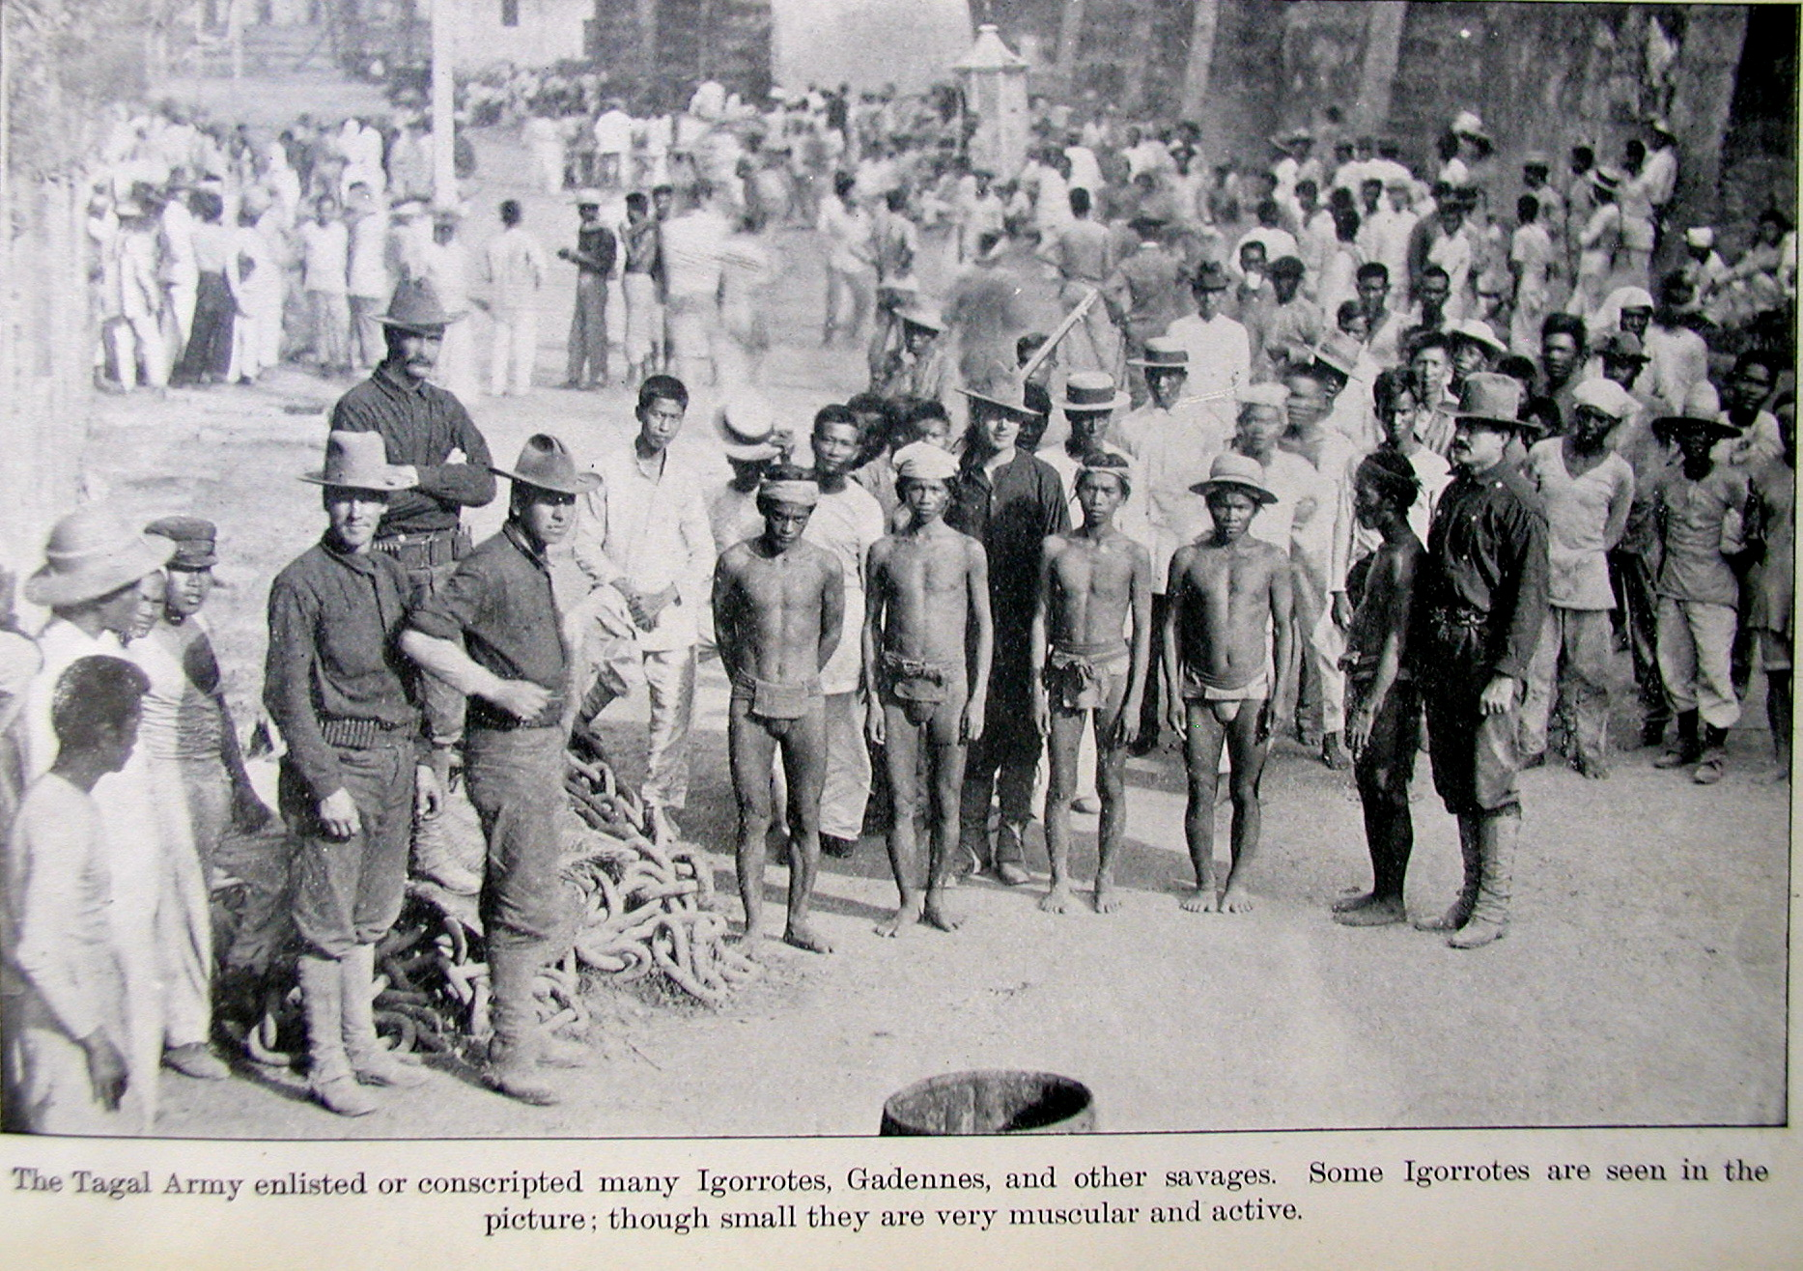

Slide 26
End of the war
Aguinaldo captured
President Roosevelt declares over 1902
Uprisings continued
Reactions to war
U.S. Progressives
Appalled by reports of brutality
Immoral to take over
Fear of “non-white” people representing the Philippines
Reason for not annexing

Slide 27
Comparison of forces
Filipino Nationalists
U.S. Military
No outside support
Geography (lots of islands)
Lack of training
Lack of supplies
Trained
Steady stream of supplies
Controlled waterways
Fresh troups

Slide 28
Pacification in the Pacific
President Taft 1900
Pacification policy
“Policy of attraction”
Goal to gain support of Filipino elites (Aguinaldo opposition)
Gave them some autonomy
GOAL: undermined revolutionaries
Provided some social reforms
1907: 1st elected assembly
1916 Jones Act: eventual independence
1935 Autonomous Commonwealth
1946 Independence from U.S. granted

