Slide 1
Society during the antebellum period
Development of an “American” identity and time of the “common man”

Slide 2
Purpose of reform
For those being helped by reformers or the reformers themselves
Humanitarians?
“Americanization”?
Drove a bigger divide between North and South

Slide 3
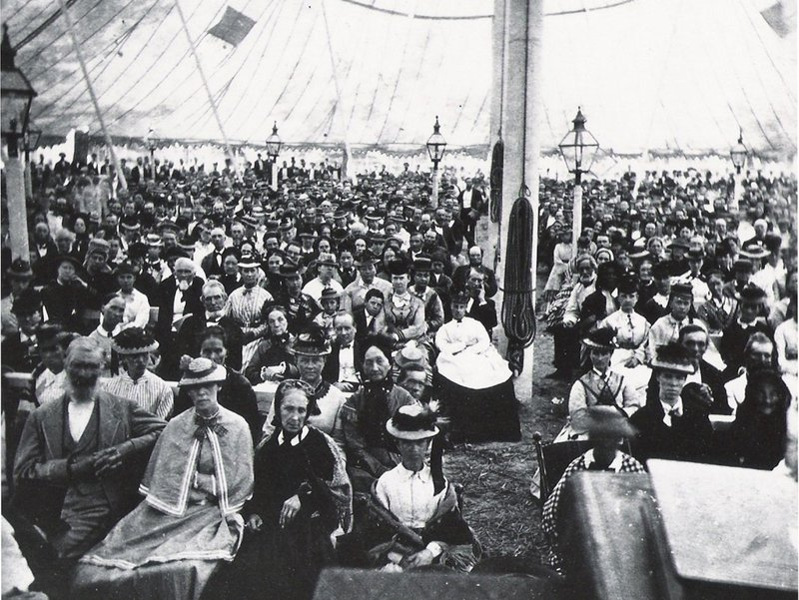
Religion
The Second Great Awakening
Impetus of social reform and activism
Backlash to Rationalism
Calvinists (Puritans)
Audience centered (like 1700s Great Awakening)
Salvation for all (democratic Christianity)
Revivals: played on fear of damnation
Western NY known as the “burned-over district”
Camp meetings
Peter Cartwright
Travel/camp meetings
Baptists
Millennialism: world is going to end 10/21/1844
William Miller
Today = Seventh-Day Adventists

Slide 4
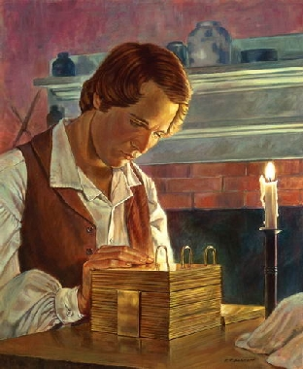
New sects of evangelicalism
Mormons
Church of Jesus Christ of Latter-Day Saints
Joseph Smith (1830)
Based on Book of Mormon
“spirit children” and goal of “fullness of joy”
Connection between American Indians and tribes of Israel
Smith restored Christianity via his vision from God
NY to OH to MO to IL
Smith murdered by mob, Brigham Young takes over
Escape persecution by going to UT to create “New Zion”
Coop system
Polygamists
Issues with US Government
Utah War

Slide 5
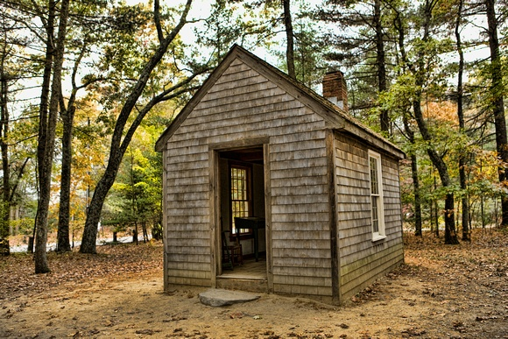
Transcendentalists: the original hippies
Emerson and Thoreau
God in nature
Individualism vs. organized institutions
Expression vs. wealth
Create an “American” culture vs. mirror Europe
Anti-slavery
“On Civil Disobedience”
Thoreau’s non-violent protest over taxes
Influenced Gandhi and MLK

Slide 6
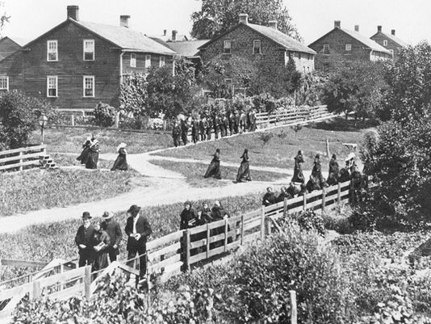
communes
Going back to early colonization…
Utopia
Lots of land
Example:
The Amana Colonies
Pietism
1714, Germany (persecuted)
1843-44 emigrated to Buffalo, NY
Move to IA for more land
No wages, assigned jobs
Attended 11 services/wk
Kids went to school till 14
6 days/wk; year round

Slide 7
“democracy” in art and literature
Post 1812 = growth of nationalism; desire for “American” culture
Paintings: everyday life, scenery
Hudson River School
Rocky Mountain School
Architecture
Greek Revival
Literature
Transcendentalists
Frontier stories (Irving and Cooper)
Intolerance and conformity
Nathaniel Hawthorne’s The Scarlet Letter (1850)
Cultural and religious conflicts
Melville’s Moby-Dick (1855)

Slide 8
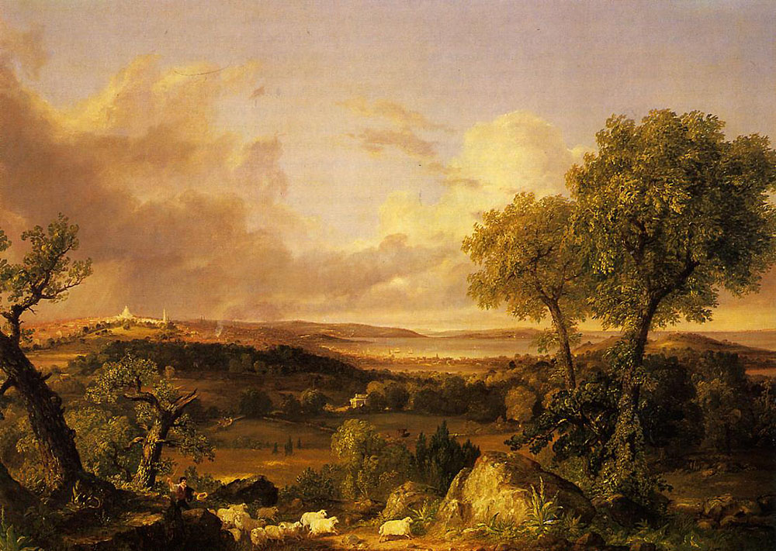
View of Boston
Thomas Cole, 1839

Slide 9
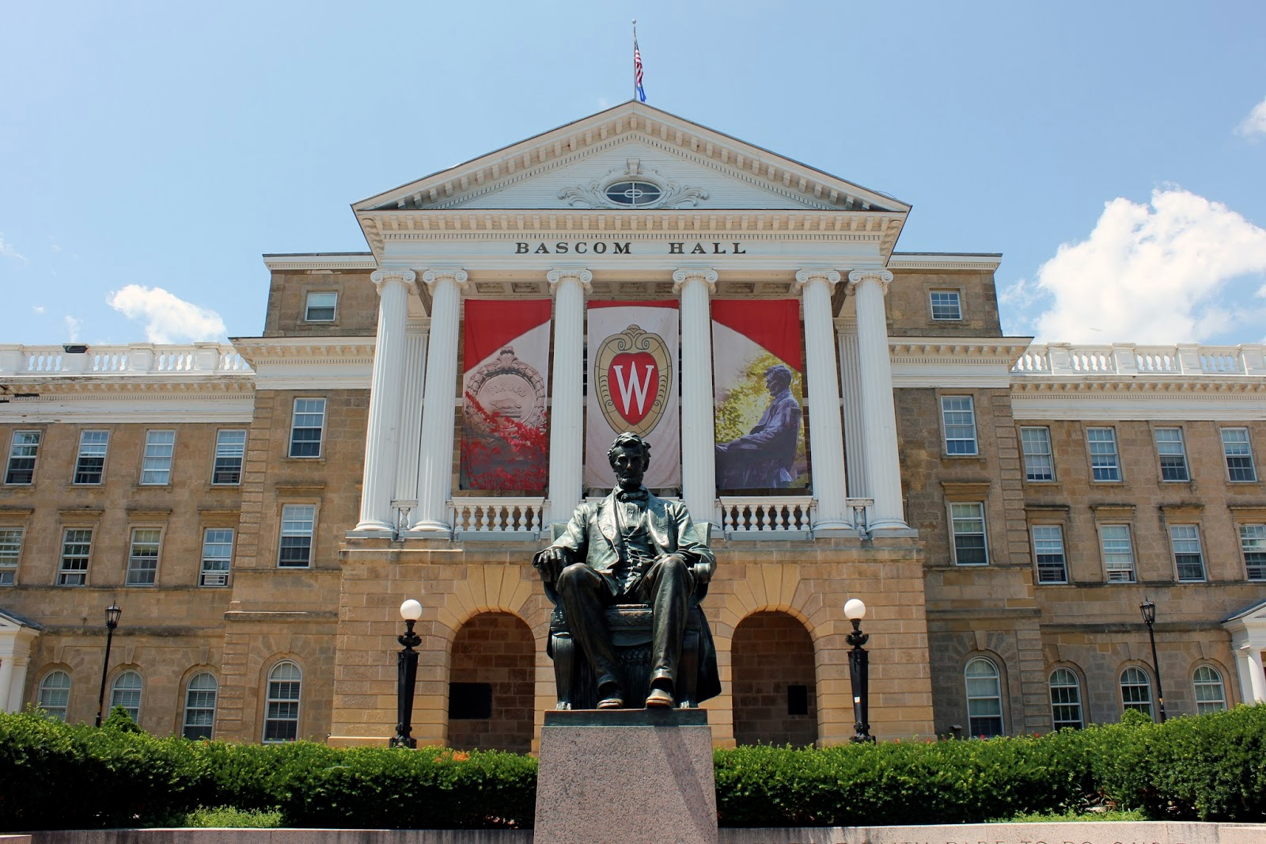
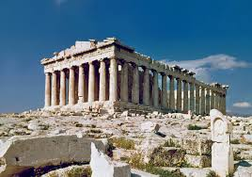
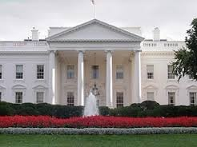
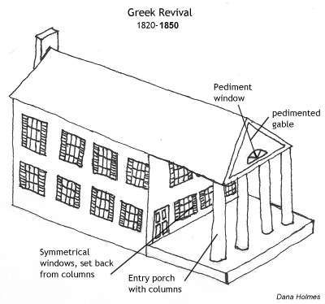
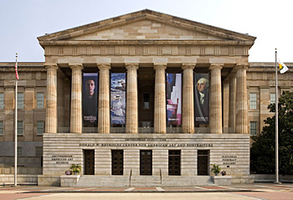

Slide 10
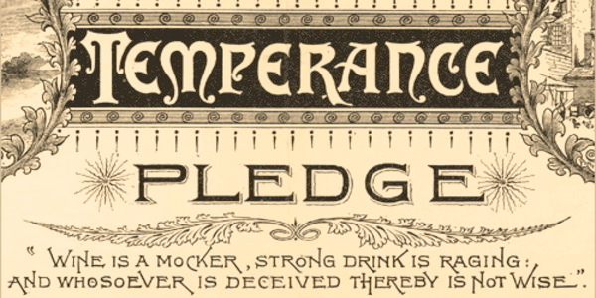
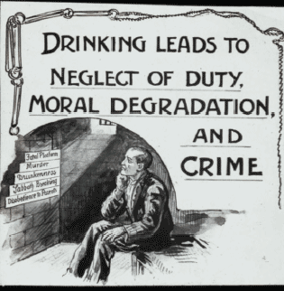
Social reforms
Temperance
5 gal/person in 1820
Alcohol = crime, social problems, poverty, low output
American Temperance Society
Pledges of abstinence
Washingtonians said alcoholism is a disease
Needs real treatment
German and Irish immigrants (Catholics)
Factory owners for it b/c it increased productivity
Overshadowed by anti-slavery movement
Prohibition
1920-1933
18th Amendment
21st ended it

Slide 11
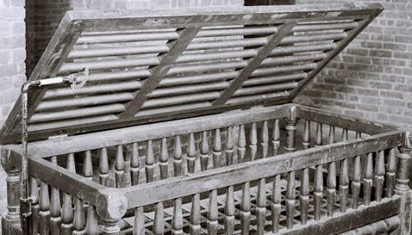
Asylum reform
Mental hospitals
People with disabilities
Dorothea Dix
Spoke to MA Legislature after touring hospitals for insane, prisons, almshouses, workhouses (started 1841)
Conditions for sick and insane: “cages, closets, cellars, pens!” (warehousing vs. care)
Dr. John Galt
Eastern Lunatic Asylum (Williamsburg, VA)
1st psychiatric hospital in US
Talk therapy
Drugs
Outpatient vs. lifelong

Slide 12
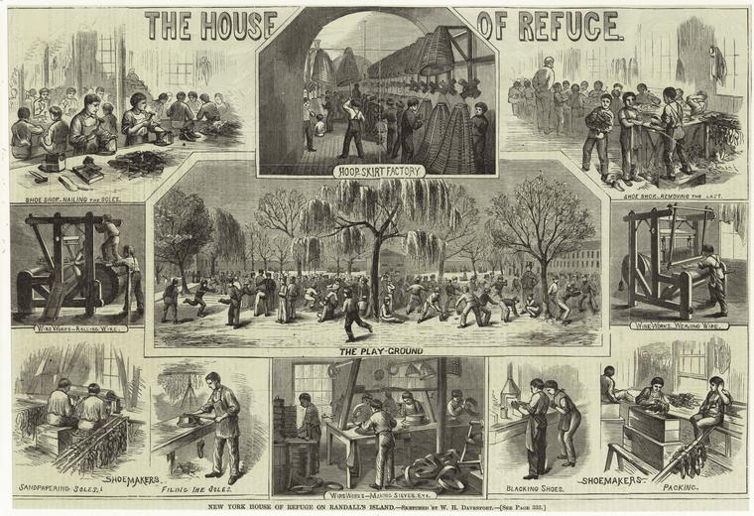
Prison Reform
Juveniles
Pre-1800 passed to parents
House of Refuge in NY – example of JDC
Post War of 1812
Crusade to move kids to JDCs, out of prisons

Slide 13
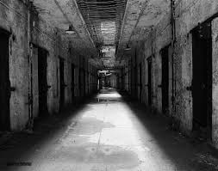
Adults
Purpose? Punishment, penitence, rehabilitation?
1821 Auburn Prison
80 men on lock down in solitary
Many committed suicide or had mental breakdowns
Resulted in strict discipline
Louis Dwight
Boston Prison Discipline Society
Salvation and Sabbath School
Dix
Libraries, literacy, less corporal punishment
Separate women, children and sick
Belief that deviants could change
Society’s vs. individual’s responsibility
1835 2 of the “best” prisons in world (in PA)
European reformers used as a model

Slide 14
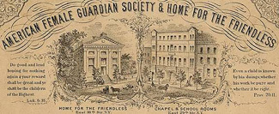
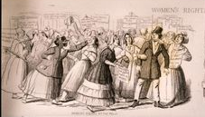
Change of women’s roles
Increased industrialization, less farming = children not “needed” as much to do labor
Smaller families
Wealthier women had more time
Religious and moral organizations
The New York Female Moral Reform Society
Keep poor women from becoming prostitutes
“Cult of Domesticity”
Changing roles
Farms = men were moral leaders
Wage labor = men were gone leaving women to run house and kids
Women as moral leaders in the home
1963 – Betty Friedan’s Feminine Mystique

Slide 15
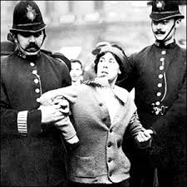
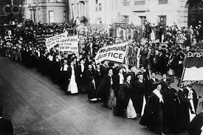
Women’s rights
Women involved in anti-slavery movements
Resented men taking leadership roles
Sarah and Angelina Grimke
Letter on the Condition of Women and Equality of Sexes (1837 – Sarah Grimke)
1848 1st suffrage movement: Seneca Falls Convention
Declaration of Sentiments
“all men and women are created equal”
List of grievances
National American Woman Suffrage Association (1890)
Formed when 2 suffragist organizations merged
Elizabeth Cady Stanton and Susan B. Anthony
1870 Anthony tried to vote, filed a lawsuit and lost
1872 did vote, arrested and 1 night in jail
Lucy Stone
2m members under Carrie Chapman Catt
19th Amendment passed 1919

Slide 16
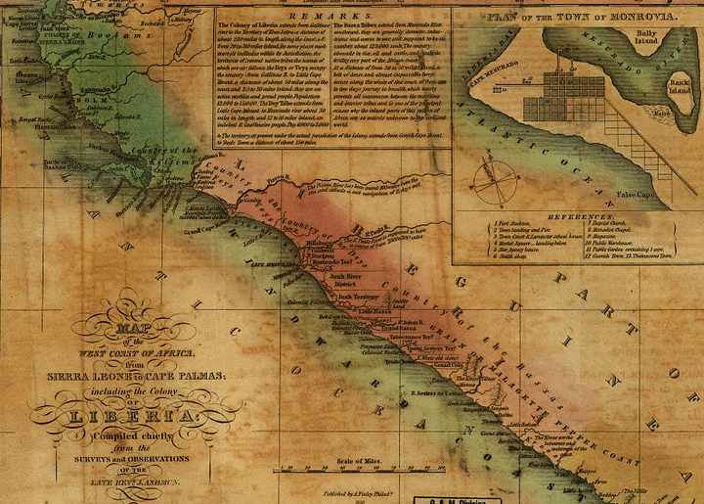
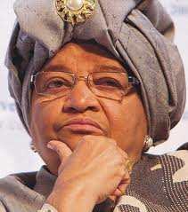
Anti-slavery
Religious/moral reasons: slavery is a sin
American Colonization Society
1st African Colony 1817
Appealed to racist antislavery reformers
Monrovia, Liberia 1822
12k African Americans settled
Slave population grew by 2.5m
Not practical
1847 Republic of Liberia established
1944-1971 William Tubman was president
Legacy of trying to bridge gap between descendants of settlers and native population
1980 coup = 10 yrs of authoritarian rule
1989 rebellion; peace in ‘97; fighting and civil unrest resumes 2000
2006 election: President Ellen Johnson Sirleaf
American Antislavery Society (1833)
William Lloyd Garrison (1831) publishes “The Liberator”

Slide 17
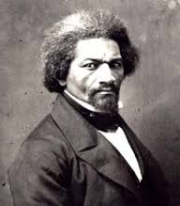
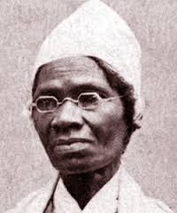
Black abolitionist movement
Frederick Douglas
Former slave
Follower of Garrison
1847 antislavery journal “The North Star”
Sojourner Truth
Nat Turner
1831, VA
Slave revolt = 55 whites killed
Retaliation = 100s of African Americans killed
Resulted in tighter suppression of anti-slavery propaganda in the South

