Slide 1
The Native American Experience
Pre-Columbian to present

Slide 2
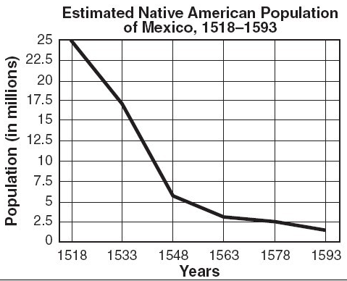
Pre-Columbus
No clear figures, but estimate 50-100m people in Americas (1/7th of world’s population)

Slide 3
Central and South America
Incas: Peru and Bolivia (capital was Cuzco)
Empire from Andes to South America’s western coast
Commoners were forced to work
Women wove cloth
Men farmed and built roads and canals (irrigation systems)
Strong state
Monarch (emperor)ruled
Aztecs: confederated empire (15-20m)
Conquered Mayan, Olmec and Toltec empires
Collected tribute from smaller tribes
Irrigation, metallurgy and construction
Priests, generals, merchants made up elite
Most farmers, artisans, soldiers and slaves

Slide 4
Wide variety of cultures in North America
Hunters/Gatherers:
Lack of resources = more nomadic (Great Basin and Great Plains)
CA, NW U.S.
Agricultural:
Maize culture
Mexico – U.S. SW
Combination:
NE – Atlantic coast

Slide 5
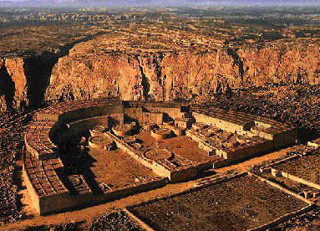
North America
1500 no real firm statistics, but est.
5m
Dispersed
Smaller groups
375 dif languages
3000BCE: SW and spreading north and east (over about 3k years), cultivation of maize evolved
Women were the farmers
Farming = settlements and stability = growth
Typically stronger tribes
i.e. Pueblo of SW (Chaco Canyon)
12 towns, 200 villages all built with contiguous rooms (housed 15k people)
Cahokia (present day St. Louis)
6 sq miles, 10k people (12th C)

Slide 6
Eastern Woodland Indians
Family based societies
Little organized hierarchy
Crops (except in far NE b/c of climate and soil)
Women in fields
Mobile population (easy to reassemble homes if needed to relocate b/c of seasons, etc.)
Kinship ties
Matrilineal: ID from mom passed to kids
Husbands moved into wives’ households
Women had some independence and power (leadership not just men)
Iroquois owned homes and fields; could divorce; could choose leaders
Common goods: land, water, harvest, hunt
Equal wealth distribution
Sense of belonging

Slide 7
Conflicts among tribes
Wars over land and resources
Formed confederacies/alliances
NE: Mohawk, Oneida, Cayuga, Onondaga and Seneca formed Iroquois Confederacy in 1400s

Slide 8
Factors that influenced the impact of European contact
Aztecs and Incas
When Spanish invaded after 1518, defeated empires quickly
North American tribes
More dispersed = less rapid demise
But, more disunity so hard to resist invasion
New diseases
Wiped out whole populations
Made it easier to conquer

Slide 9
Columbian Exchange
Europeans had contact with Americas and Africa
Exchange of plants, people, goods and microorganisms
New seeds
New crops (for Europe)
New invasive species (for New World)
New diseases (for both)
No immunities
Typhus, measles, influenza, and smallpox
90% of native people wiped out by 1600
Syphilis spread in Europe quickly post 1520s

Slide 10
Spain
Spain: Conquistadors (Cortes)
Seize land and gold for God and King
Forced native people, and eventually Africans, to work for them (couldn’t convince colonists to emigrate)
Encomienda system
Spanish crown grants land and the inhabitants to a conquistador or colonists
Replaced by repartimiento system: involuntary labor, but compensated
Not all Spanish supported
Las Casas and Montesinos (priests)
Las Casas realized there was a lot of work to be done, but against cruel treatment of Native People
Slaves from Africa as a solution

Slide 11
France
Jacques Cartier 1534
St. Lawrence River
French and Dutch: furs, trade
1st settlements were on coast b/c of fishing
Semi-permanent
Intermarriage
Trade relationships
More about exchange than conquest

Slide 12
American Policy towards Native Americans (before and after the Revolution)
Historically has been “removal”
Revolves around:
Landownership
Competition for resources
Culture collisions
Europeans immigrating to have a new identity and own land
Indians do not practice private property/landownership
Used as justification: “inferior” pagans
Push back or genocide

Slide 13
Algonquian (1610)
1st permanent English Settlement: VA
Europeans treated the Indians like other Europeans (needed help)
Native Americans: no frame of reference, didn’t know who (what) they were dealing with
Resistance by Native Americans: successful b.c Europeans were not fit for the new land
Maintained their place throughout conflicts
Eventually pushed west

Slide 14
Pequots (1637)
Conneticut
Originally a peaceful relationship w/Europeans
1637 – war over land
Don’t realize what they are up against – see as another tribe
Downfall: role of other tribes
Europeans allied with tribes to play them against one another
No “gentlemen’s agreement” when the Europeans win (like in Euro wars) – killed off remaining warriors or sold into slavery

Slide 15
King Philip’s War 1675
Massachusetts
Metacom: Chief of the Wampanoags
Called King Philip as an insult
“who does he think he is? A king?”
Wampanoags helped the Europeans farm
Not enough – the Europeans wanted their land
European war party went to main village
Slaughter 250 people: women, children, elderly
Used the opportunity when warriors were away
Demonstrated the extent of their brutality; instill fear

Slide 16
Legacy of King Philip’s War
Wake up call about European intentions
Narragansetts allied with Wampanoags, along with Abenaki and Nipmucks
Lost about 10% of their male population in 1675 battle with the English
European advantages
Aid from NY
More united against the Indians
More of them
More animosity w/i various tribes
i.e. English ally with Mohawks against the Wampanoags

Slide 17
“beneath” the Europeans
Bacon’s rebellion: started because the King didn’t offer support to keep out Native Americans/help take Indian land
Killed 300
Unified poor white and black laborers/farmers
All against the Indians
All are superior over the Indians, regardless of relationship

Slide 18
Attempts at enslaving
Most tribes practiced some form of slavery of war prisoners
Europeans needed labor – especially for farming sugar, cotton and tobacco
Tribes would sell war prisoners to the English/Spanish (amplified rifts between tribes)
Native Americans were less desirable
Men were typically hunters and were not experienced in the fields
More likely to escape
Were afraid of African/Indian alliances where free Indians would try to free both

Slide 19
More Indian Timeline
Tuscarora (1711)
2 year war with English in NC
Tried to enslave
Pushed west
Iroquois (1700-1740s)
Displaced; beginnings of westward push
Resist, but the Europeans keep coming
Chain reaction: relo one group, they relo another… ripple of displacement

Slide 20
Revolutionary War: Acceleration of Removal Process
War exasperates the situation
French and Indian War & Rev. War (1754 – 1781)
Many united w/French
Defeated = opens up more English expansion
The English government does not want to protect the land (Proclamation of 1763) past Appalachians
Americans more determined to expand (King and Indians in the way)
Indians tend to side with British because thought the best bet to keep land

Slide 21
Shawnees (1780-1810)
Rev. War over, Americans focus on Native Americans
Confederacy of tribes form (about 5)
Common cause
America’s reaction: sent troops to Ohio
Shawnee kill 900 of 1500 soldiers
Short lived victory
Americans return with 3k
Pushed Shawnees west of Mississippi River
War of 1812
Seen as an opportunity
Tecumseh leads war party from the north (not from home, because that is sacred)
Defeated
End of Indian Revolutions
Except Seminoles

Slide 22
Manifest Destiny
Belief that this country should and will be “ours”
Our right, our destiny because Americans (white) are better than all others
God’s will – because we’ve overcome so many obstacles already
Sea to Shining Sea

Slide 23
Indian Removal Act (1830)
Formal system of removal (“containment”)
More random before
President Andrew Jackson
War hero for fighting the Indians
Goal to “eliminate the Indian threat”
All Native Americans east of the Mississippi have to move west
20k forced out to Oklahoma

Slide 24
2nd Seminole War (1835)
Osceola is their leader
Florida
Sheltered African Americans
Not egalitarian, but realized surrounded by Europeans, so needed to grow their ranks by bringing in “Maroons” (African American refugees)
1st Seminole War was in 1812 and Jackson lost
2nd was 7 years; 1600 U.S. soldiers died
Ends because Osceola tricked into a peace meeting and is decapitated
Treaty never signed, but were displaced – Seminoles removed from FL
Never recognized the U.S. gov’t

Slide 25
Trail of Tears: 1831 started
Choctaw 1st to be removed (1831)
Cherokee, Mucogee, Seminole, Chickasaw, Choctaw = The Five Tribes
Set up own formal government
Went to U.S. Supreme Court
won, shouldn’t have to move
Jackson left it up to the Court to govern…
Court doesn’t have an army
Jackson oversteps his executive powers and forcibly marches them from GA to OK
¼ die
800 miles

Slide 26
Reservation System (1850s)
Gold Rush (1840s, CA)
Desire for land
Fear and violence
“lock up” the Native Americans
OK, SD, MT
Some received land that was already theirs: Lakoda in Black Hills
Nation w/i nation = Reservation
Won’t provide infrastructure of the rest of the government ($ for education, healthcare, etc. left to selves)
We’ll tell you where to live

Slide 27
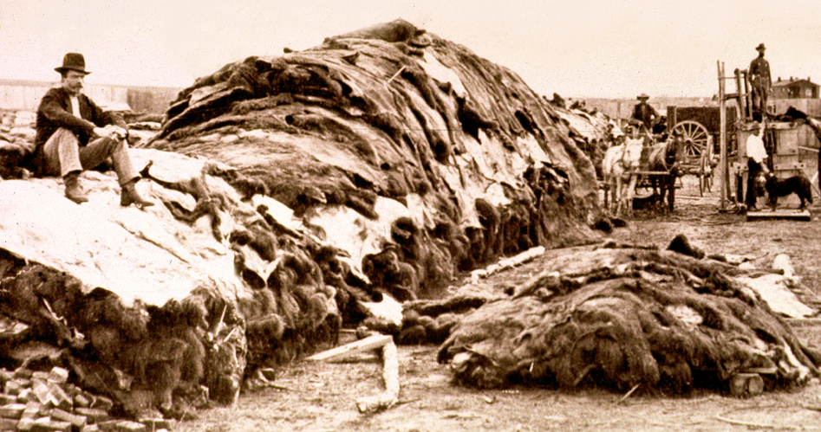
Black Hills
Land of the
Cheyenne, Arapaho
and Sioux
Sacred land
Gold found
Treat of 1868
Sioux and Lakota as long as there are buffalo
Gov’t wants them moved (turns out the land is valuable)
1872 – Buffalo slaughter peaks
“sign or starve”

Slide 28
Post Civil War
1876 Battle of Little Big Horn
Refocus on common “enemy” vs each other (North vs. South)
Discontent with reservation confinement
U.S. gov’t hasn’t lived up to their end of treaties in the past
Custer came in with troops
Crazy Horse/Lakota and Sioux tribes gathered (10k warriors)
Attacked U.S. troops
Guerilla warfare, surrounded, and on higher ground
Lasted 25-30 min
No prisoners
Demonstrated Sioux tenacity

Slide 29
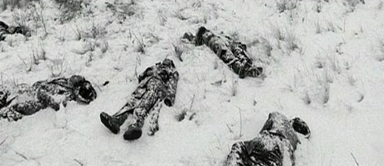
Massacre at Wounded Knee 1890
Pineridge, SD
Retaliation for Little Big Horn
Local Indian Representative posted at the reservation cabled U.S. government: “acts of rebellion”
cultural practices were considered “rebellion”
punish this…

Slide 30
Troop comes in while Lakota are having a Ghost Dance
Not clear how it started…
“1 resisted” (didn’t know to drop his gun) when confronted
300-350 Lakota killed when army circled and opened fire
Aftermath of Wounded knee: cultural warfare
Remove culture and assimilate or eliminate

