Slide 1
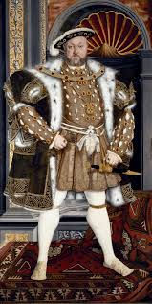
Carter Questions…
Wars of the Roses: 1455 – 1485; England: House of Lancaster (red rose) vs House of York (white rose)
Henry VI: crazy
Richard III (last Yorkshire king) defeated by Henry Tudor (Henry VII)
English Reformation: 16th Century; Church of England broke from Catholic Church
Spurred by Henry VIII desire for annulment
Political differences with Rome

Slide 2
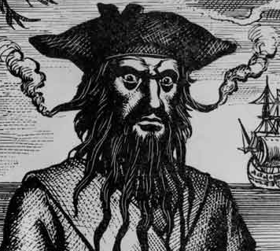
Why are there 2 Carolinas?
Originally Carolana Colony (not Carolina)
French were 1st, driven out by Native Americans
Hard to govern: corruption, malaria, small pox, Native Americans at war with each other and colonists
Pirate Blackbeard: sailed up and down coast on Queen Anne’s Revenge
1629 Sir Heath claimed Cape Fear under King Charles I; no effort to colonize
King Charles I executed (Cromwell lead civil war, Charles goes against Parliament)
Heath goes to France
King Charles II: gives land to 8 person club of rich white guys: “Lords of Proprietors” (1663-1729)
Lords: fought, deposed, overthrown, banished, imprisoned…
Unclear as to exactly how the borders came about: Native American tribal disputes, corruption, etc.
1729 recognized as NC/SC separate royal colonies

Slide 3
The Road to Revolution

Slide 4
Leading to War: Focus on Immediate Causes
French and Indian War (1754-1763)
Over British control over the colonies
French and Indians vs. Americans (and British)
Native Americans views of French and British differed
French:
Established trade routes
Not settling
Great Lakes/Mississippi River
Pushed east to increase trade
As far as Virginia

Slide 5
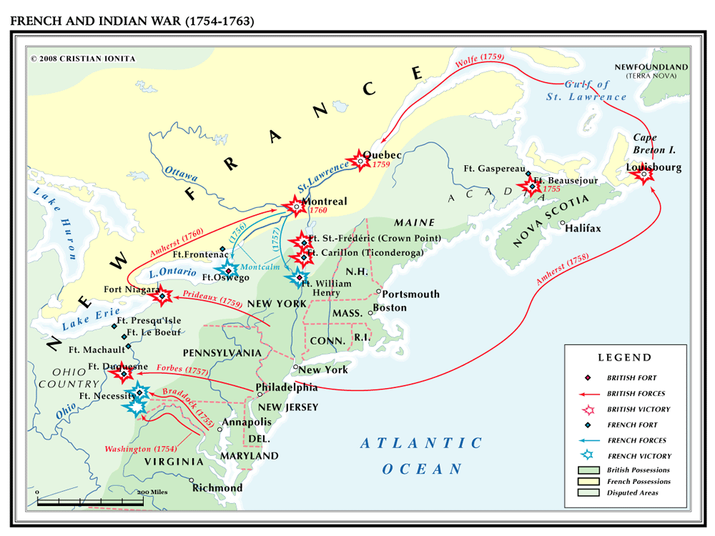

Slide 6
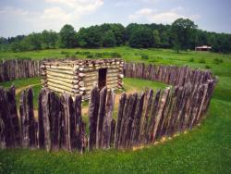
Fort Necessity
Governor of Virginia sends Capt’n George Washington to investigate
Ambushes the French
French retaliate
Fort relinquished to French
Start of war

Slide 7
Picking Sides
Many Indians side w/French because they are not trying to displace them
British initially not interested in getting involved
Colonists got themselves into it…
Only reason why was to retain colonies
French lose
Lose land to British
British demonstrated their superiority

Slide 8
British Superiority: Post French and Indian War
Conscription: Brits can force colonists to serve in the military
If they can do this, what else can they do??
Brits start restricting movement of the colonists
Post war migration of colonists west b/c the Indians were gone
If their were Indian hostilities, the British would not protect colonists
King George III restricts movement past the Appalachians because of the cost to defend the colonists
Controls colonists
arbitrary

Slide 9
More British Restrictions
Quartering Troops
Colonists have to provide food and shelter for troops with no restrictions or warning
Lowest ranking British soldier is always higher than highest ranking American soldier
Americans are inferior to the British
Taxation w/o representation
We fought for you – now pay up
Can tax w/o any input or representative from the colonies

Slide 10
Acts: Part 1
Sugar Acts (1765)
High demand for sugar = lots of smuggling
At the time, lawbreakers were judged by jury of peers
New Acts did away with this – now an overseer of cases
Stamp Act (1765)
Everything needs to have a stamp on it
< protests; < unification identity as Americans

Slide 11
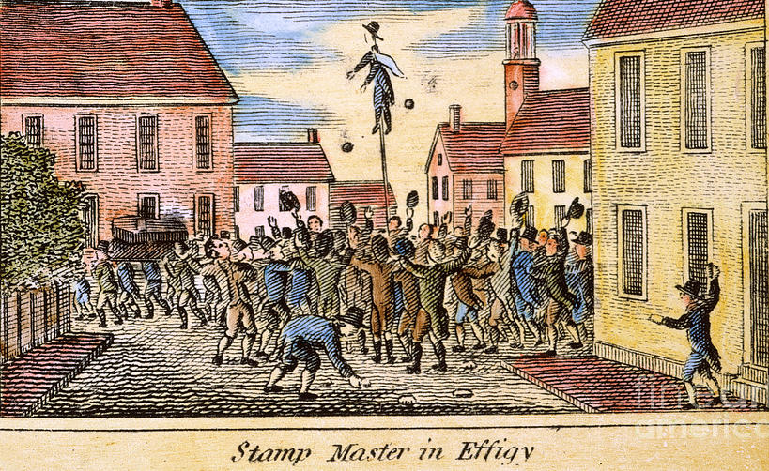
Acts Part 2
Townsend Acts (1767)
More taxes
Eliminated the colonists ability to control salaries of government “representatives”
Prior, officials appointed by crown, but colonists had some control of salaries

Slide 12
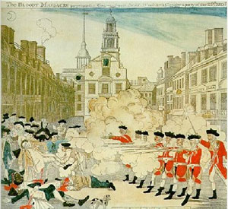
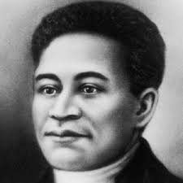
Violence
Boston Massacre (1770)
Angry, frustrated citizens w/control of crown
Americans provoke by the British soldiers (throwing things)
4 die
Crispus Attucks (African American)

Slide 13
More violence
North Carolina Uprising (1771)
Independent farming traditions
United
Geography = permits guerilla warfare
Leaders executed (British making example of them)

Slide 14
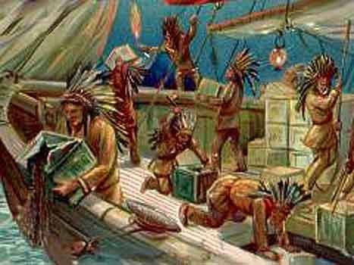
And more violence…
Boston Tea Party 1773
Reaction to Intolerable Acts
Boston radicals
Want more control of resources
Goal was to draw attention to movement
English were selling tea at predetermined prices
Americans were fed up
Dress up as Mohawk Indians (symbol of resiliency)
Toss tea in harbor

Slide 15
Response to the Tea Party: Intolerable Acts (Coercive Acts)
Boston Port Act: Closed Boston Harbor – Americans had to pay reparations
Massachusetts Government Act: Increased British Authority – Banned Town Meetings
General Gage (British General of N American Troops)
Administration of Justice Act:
British soldiers and officials were not tried in MA
More freedom for officers
Marshall Law (no civil rights – all up to the British)
Oppression draws attention: more recruits for radicals
Create militia

Slide 16
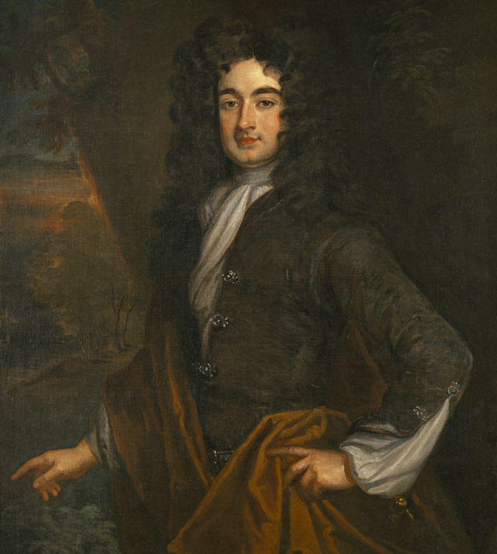
Who’s involved?
Upper & Middle classes
Think they should be in charge
Ok to disenfranchise lower classes (even though all of them)
Bore the brunt of Stamp Act
Wanted to expand holdings (against the movement restrictions)
Working classes
Conscripted
Taxes disproportionate to income (bigger impact on lower incomes)

Slide 17
Loyalists
Strong minority
Especially in South
Maintain British relationship (trade; gentry-system; GB is largest consumer)
Tradition: stick with what you know
Economic ties

Slide 18
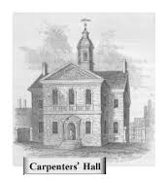
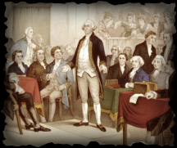
And?
September 5, 1774
First Continental Congress met in Philadelphia

Slide 19
This Town has received the Copy of an Act of the British Parliament, wherein it appears that we have been tried and condemned, and are to be punished, by the shutting up of the harbor and other marks of revenge, until we shall disgrace ourselves by servilely yielding up, in effect, the just and righteous claims of America....The people receive this cruel edict with abhorrence and indignation. They consider themselves as suffering the stroke ministerial...I hope they will sustain the blow with a becoming fortitude, and that the cursed design of intimidating and subduing the spirits of all America, will, by the joint efforts of all, be frustrated.
– Samuel Adams, letter to James Warren (May 14, 1774)

